Slide 1

Computer based filing system

Slide 2
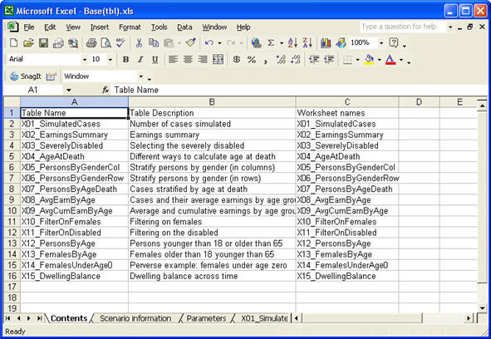
Microsft Excel

Slide 3

PHP and MySQL

Slide 4
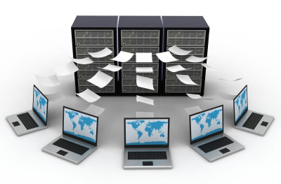
Client-server database communication

Slide 5
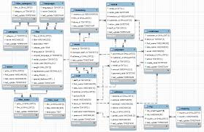
Relational Database

Slide 6

Website

Slide 7

HTML5

Slide 8

NodeJS

Slide 9
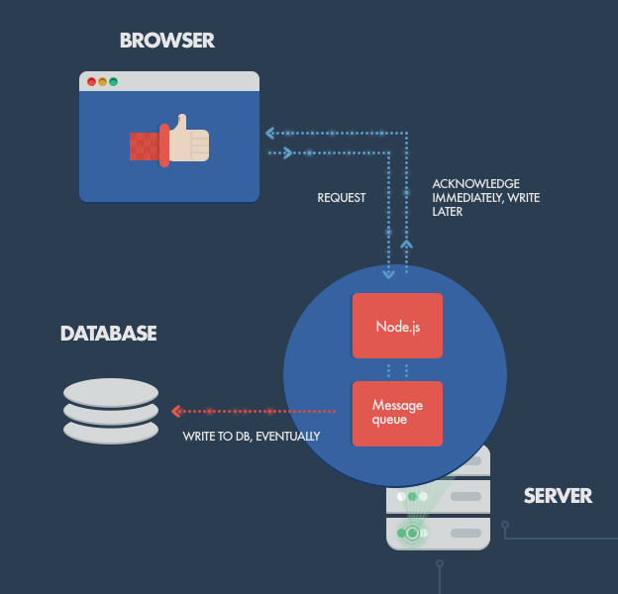
Handling web requests

Slide 10
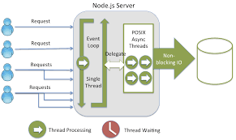
Example

Slide 11

CSS for UI

Slide 12
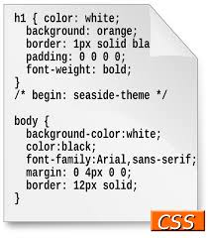
Example

Slide 13
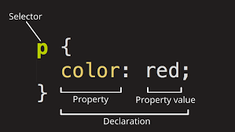
Example

